Slide 1
On Weather and its Effects on Chicago Crime
A data driven analysis on how weather relates to crime rates
Francisco H | Mansi S | and John Y

Slide 2
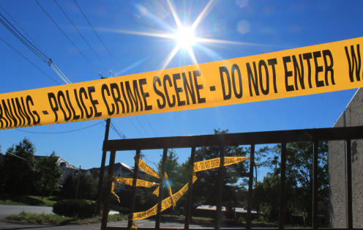
Question
How does weather affect crime in Chicago?
Hypothesis
Warmer weather is responsible for more people outside and more chances for street crimes to occur.
Prediction
Of the weather metrics looked at, temperature will have the strongest, positive correlation to crime.

Slide 3

The Data: Sources
Weather Data
Crime Data
Open Weather Map
6 years of data for 1 city = $10
JSON file
https://openweathermap.org/history-bulk
CPD Data Portal
Free
CSV file
https://data.cityofchicago.org/Public-Safety/Crimes-2018/3i3m-jwuy

Slide 4
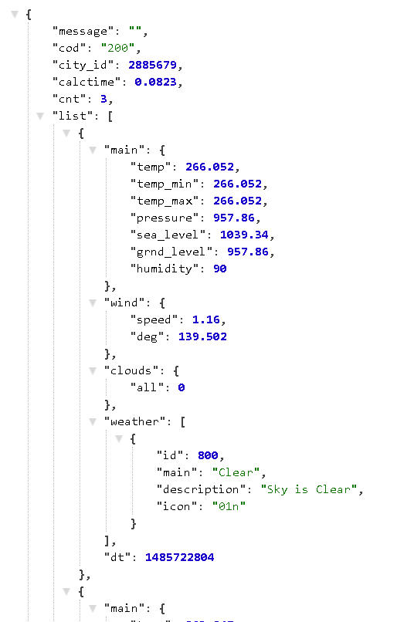
The Data: Weather Exploration
JSON file provided easy handling of data
  Feeling loopy
Date and Three weather metrics (Max Temp, Humidity, and Cloudiness)
Some Hiccups
Date was UNIX timestamp (1349096400)
JSON entries by the hour
Temperature in Kelvin, not Fahrenheit
Missing dates (8/8/2014-6/12/2015)

Slide 5
The Data: Weather Cleanup
UNIX timestamp
Hourly JSON entries
Temperature in Kelvin
Missing dates
pd.to_datetime function
dt.date function
pyt.k2f function
dropna after merging
1349096400 to 2012-10-01 13:00:00
Take only y/m/d then .mean
287.59 K to 57.97 F
Avoid skewed data

Slide 6
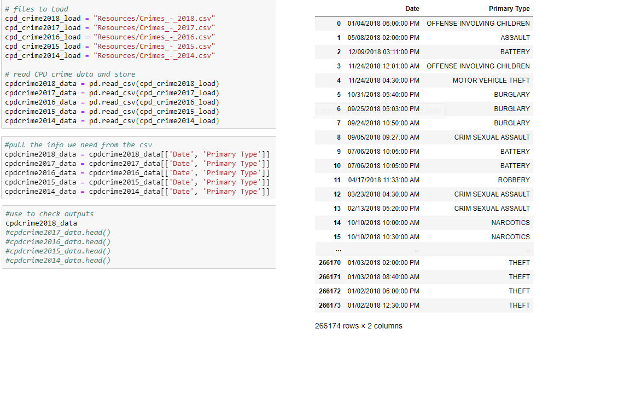

The Data:
Crime Exploration
The Easiest Part!
Load in the huge amounts of data
Extract the general data we need

Slide 7

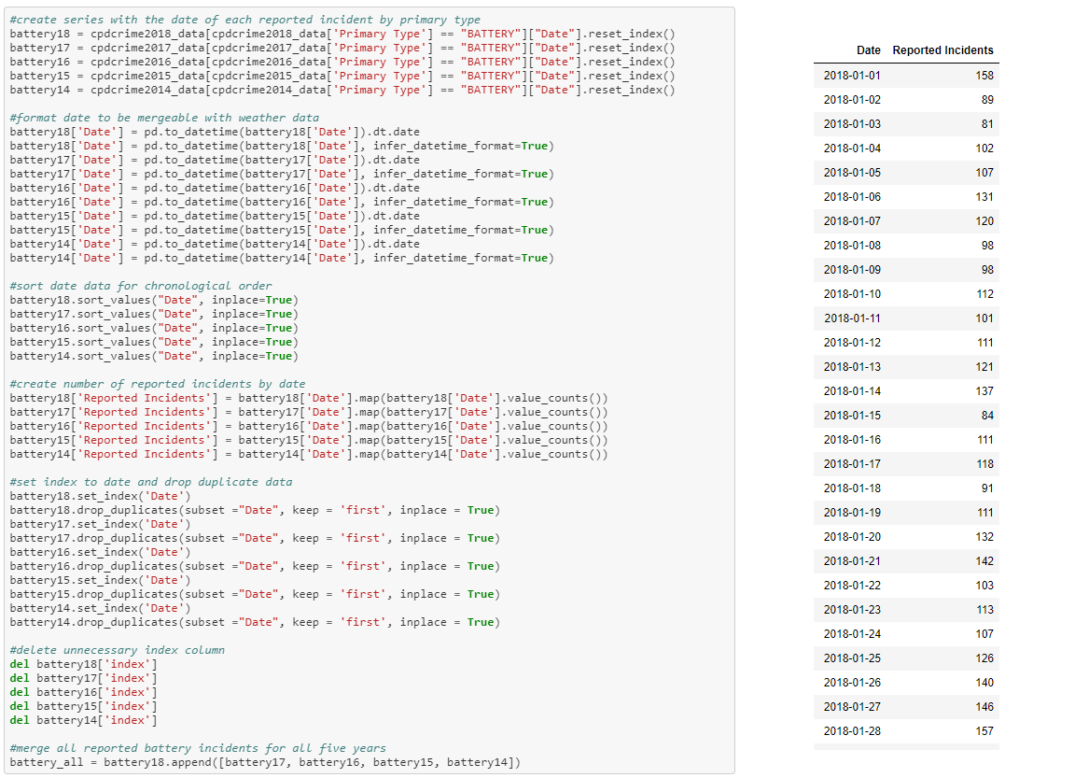
The Data:
Crime Cleanup
First we pulled the specific crime we wanted to look at and saved the date of each reported incident
Looking ahead, we format the date so it can be mergeable with OpenWeatherMap data
Next we sort by date to make it easier to look at
Then we value count the dates to get the number of reported incidents per date
Now we set the Date to be the index and drop any duplicate sets of dates and reported incidents
Finally we have clean data for each crime for each of the last 5 years. We create all the data for five years into one. Repeat for each specific crime we want to explore.

Slide 8

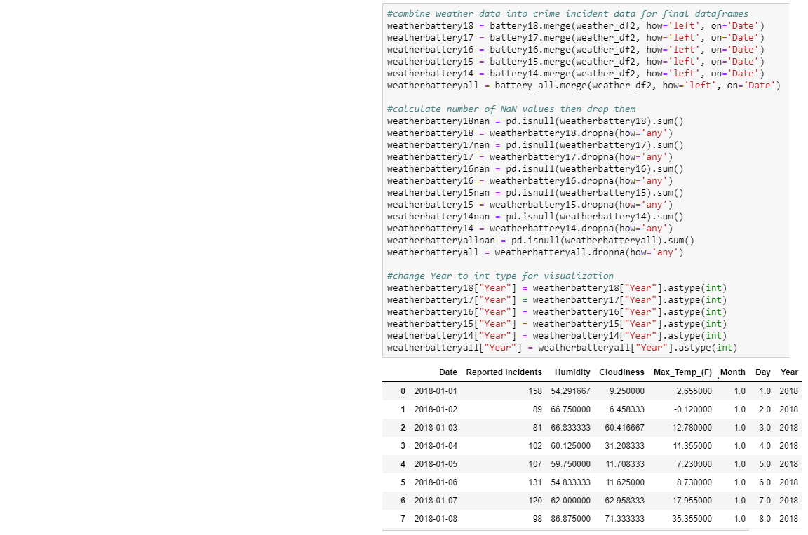
The Data:
Merging Weather
We merge the weather file into each crime/year file on date because we can easily filter out any dates without a reported incident for that crime
We count up all the NaN values and record it and then drop all of them
We reconfigure the Year column into an integer so the years don’t read with a .0 in our visualizations

Slide 9

The Data:
Problems and Insights
Problems
Our issues we didn’t foresee during data cleanup mostly had to do with breaking down the data enough to be able to use for visualization. In a plethora of provided data, there are still lots of bridges to be built inbetween them to get seemingly easy information.
  One of the easier examples of this getting the combined number of reported incidents for a specified crime per date
  Another example is breaking down the Date into Month, Day and Year so grouping and visualization wasn’t limited to one specific variable (YYYY/MM/DD)
Insights
One insight we had was that there was so much data, we had a lot of visualization and comparison choices that we could choose from
Another insight we had was that when people are working on a project together, placement of some code pertaining to make things visually appealing matters because of the overlap.
  E.g. code taking out .0 from the end of the Year worked better later down the code ladder than where it originally was

Slide 10
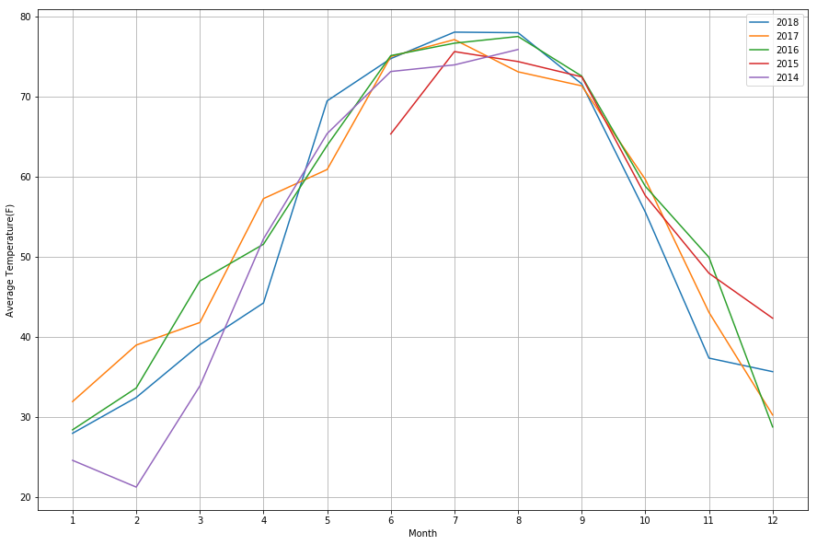
The Data: Analysis Process
Let us first look at trend in temperature in the past 5 years.
The incomplete line is due to insufficient data that wasn’t recorded from August 2014 to June 2015

Slide 11
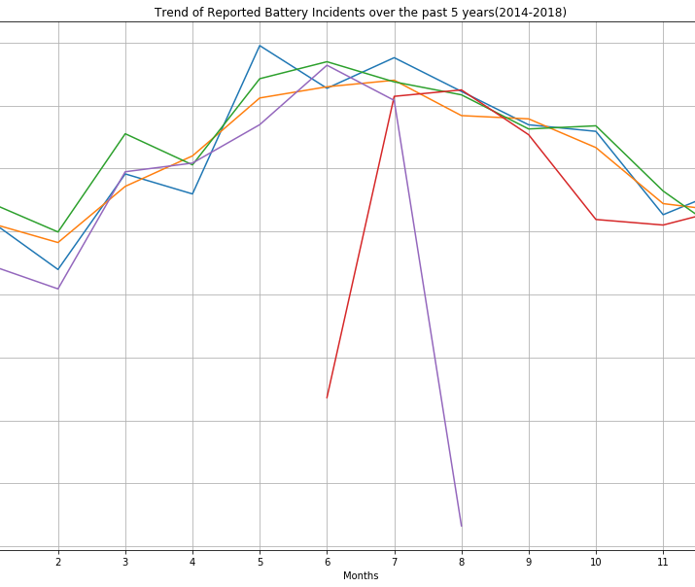
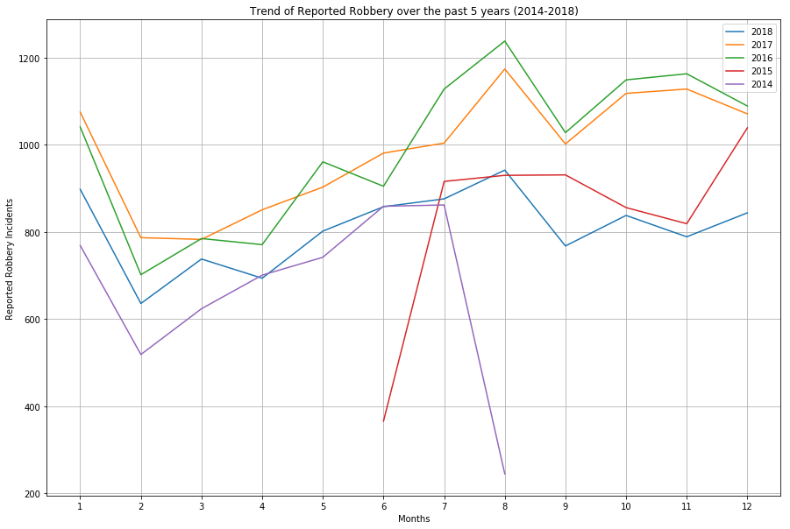
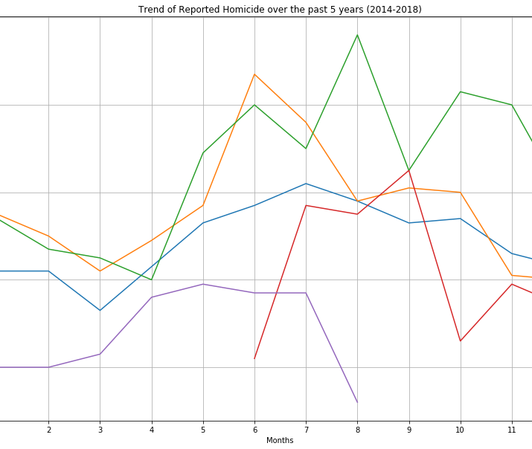
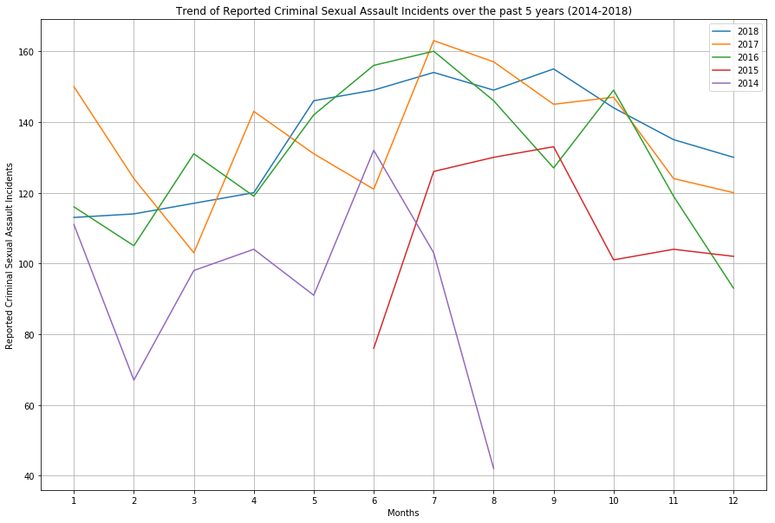
Now let’s take a look at the Trend in 4 Categories of Violent Crimes in the past 5 years

Slide 12
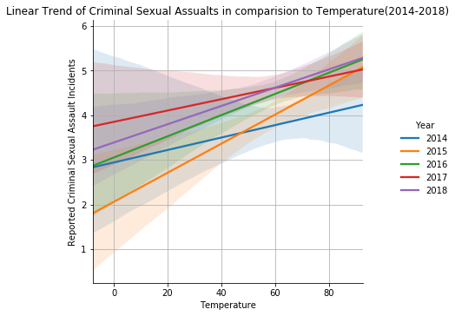
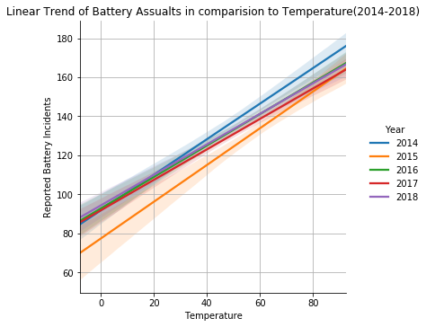
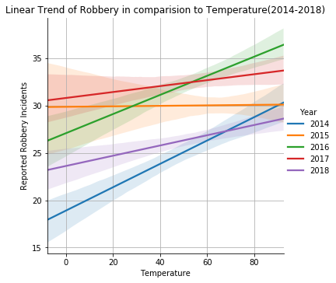
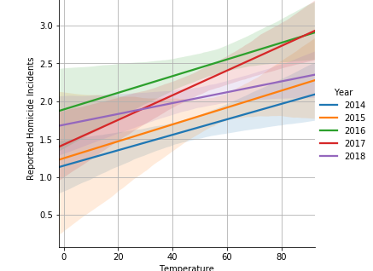
Does a hot summer mean more crime?
Here's what the data shows:

Slide 13

Statistical Analysis: Pearson Correlation Coefficient
correlation coefficient is a measure of the strength of the linear relationship between two variables.
A perfect positive linear relationship, r = 1.
A perfect negative linear relationship, r = -1.

Slide 14
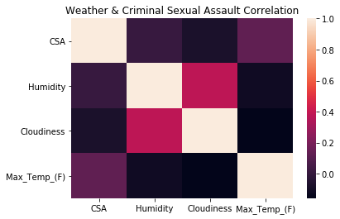
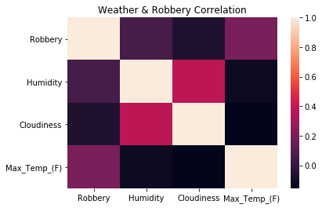
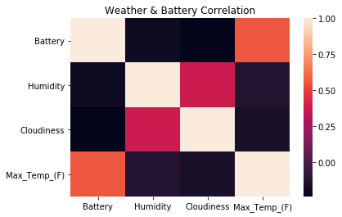
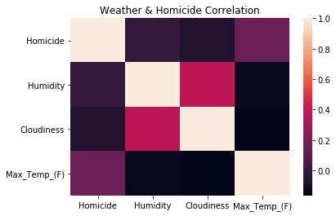
Weather & Crime: Pearson Correlation

Slide 15
If we had two more weeks, We would have
Researched how to manipulate file and variable names, and loop the CPD data based on the year of the csv file
1.Compared the crime on weekdays vs weekends. Especially in the hotter months. 2. Analyzed if Snow or Rain had any affect on the Crime rate
Tried to analyze if the police presence was more, since more people are outside during the summer, to see if that affected the rate of crime in someway.

